Slide 1
^{Z Test example}
A County Council is concerned about a news published in a local news paper regarding low wages paid to farm laborers. According to the news report, the farm laborers in the county are paid lower than the state level average. The state level average wage of farm workers is 700 per week with standard deviation of 10.
The council conducted survey of randomly selected 100 farm laborers in the county. The mean weekly wage of surveyed farm laborers is 698.5.
What is the conclusion at 5% level of significance?

Slide 2
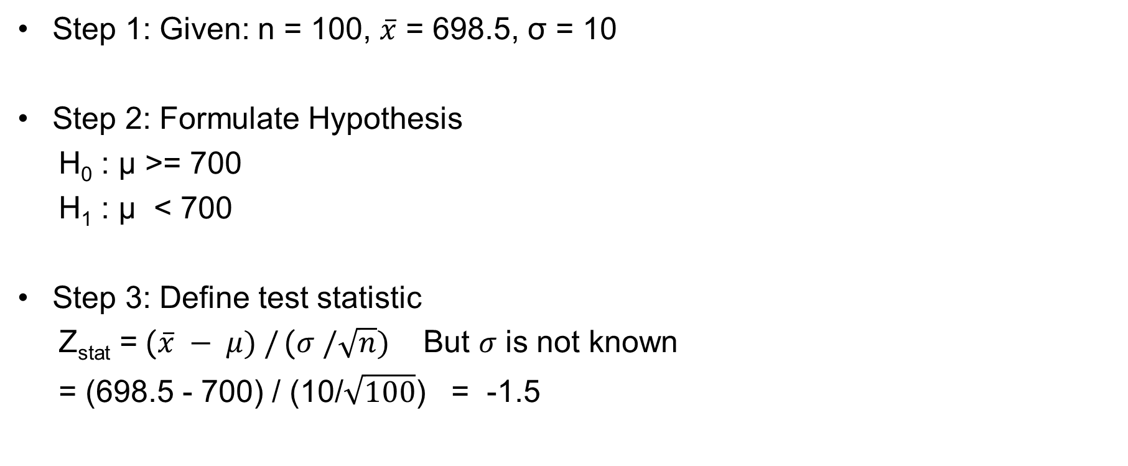
Example – Farm worker wage
Step 1: Given: n = 100, $\overline{x}$ = 698.5, σ = 10
Step 2: Formulate Hypothesis
H₀ : µ >= 700
H₁ : µ < 700
Step 3: Define test statistic
Z_{stat} = ($\overline{x} − μ) /$ ($σ /\sqrt{n})$ But $σ$ is not known
= (698.5 - 700) / (10/$\sqrt{100}$) = -1.5

Slide 3
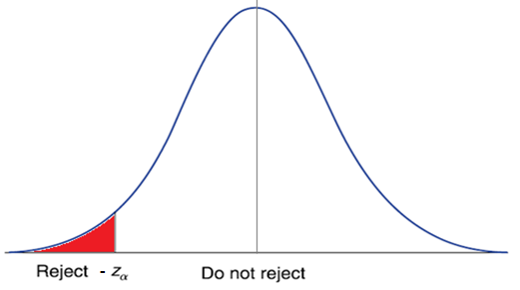
Example – Farm worker wage
Step 4: Draw diagram
Step 5: (p-value method)
Find p-value.
P-value = pnorm(-1.5)
= 0.0668
Step 6: (p-value method)
Since p-value > α, therefore do not Reject Null Hypothesis

Slide 4
Example – Farm worker wage
Step 5: (p-value method)
Find p-value.
P-value = pnorm(q = zStat)
= 0.03
Step 6: (p-value method)
Since p-value < α, therefore Reject Null Hypothesis, i.e. Accept Alternate Hypothesis

Slide 5
^{t Test example}
An insurance company has the business objective of reducing the amount of time it takes to approve applications for life insurance. The approval process consists of underwriting, which includes a review of the application, a medical information bureau check, possible requests for additional medical information and medical exams, and a policy compilation stage in which the policy pages are generated and sent for delivery. The ability to deliver approved policies to customers in timely manner is critical to profitability of service. During a period of 1 month, you collect a random sample of 27 approved policies and the total processing time in days is stored in Insurance.
In past the processing time was 45 days. At 0.05 level of significance, is there evidence that the mean processing time has changed from 45 days?
What is the assumption about population distribution needed in order to conduct the t test
(Problem from book Page 313 adapted for class discussion)

Slide 6
^{t Test example}
Formulate hypothesis
H₀: µ = 45
H₁: µ ≠ 45
What are degrees of freedom?
tStat = -0.228
p-Value = 0.82
What is the conclusion?

Slide 7
2-t test Independent samples - example
An NGO wanted to check if there is difference in salaries of male investment bankers and female investment banker working in New York and having 3 to 5 years of experience. They selected random sample of 10 male and 10 female financial analysts meeting the criteria. Their annual salaries are in Salary1.
At 95% confidence, what is the conclusion?
What is the assumption about population distribution?

